Slide 1

Gravity
GERMANY DUAL RUN
Other MQs – DWP
May, 2024

Slide 2

Gravity | Dual Run Launchers
OnLine Banking - Diagrama funcional
Dual Run
OBHENMIC
Main features
Mainframe
DWP
Launcher
Send Response from Master - OK/KO
Gravity
Comparison Log results
MONITORING

Slide 3






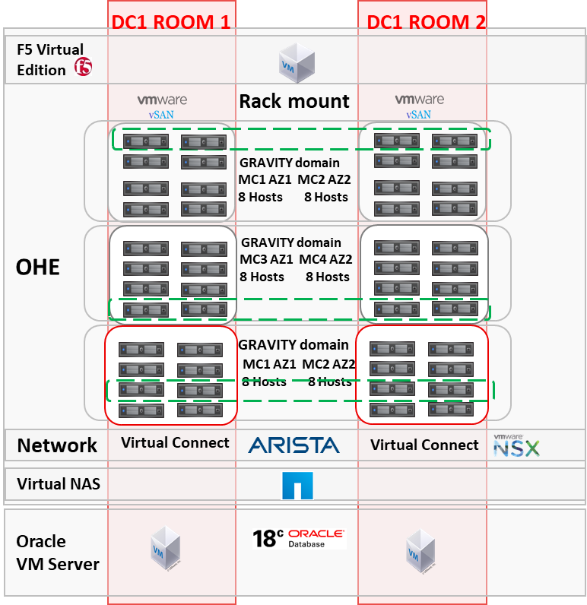




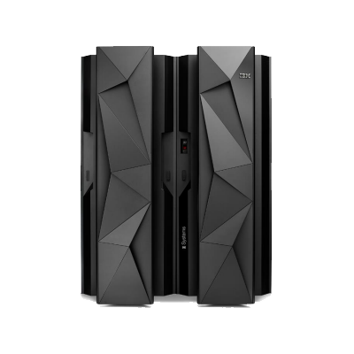


DWP01
Option 1
Gravity | Dual Run Launchers
CERT Microfocus
OnLine Banking – Diagrama de Integración
PRE GER
Dual Run
MQ Queues tempate
SOHCR
MQ Manager
MQGRSCGI1
1414
MQGRSCGI2
1415
SAN.WPIO.BONL -> SAN.WPIO.BONL
MQ Manager
MQLASCGI1
1414
MQLASCGI2
1415
Channel
CLNT.JAVA_DWP
MQ Manager
DWPT1
1415
DWP
LQ.DWP.BONL.SAN <- LQ.DWP.BONL.SAN_GRA
DUALDWPENV01 <->
SAN.REQUEST.DWP -> SAN.REQUEST.DWP
DUALDWPREC01 <->
LAUNCHER
LQ.DWP.BONL.SAN <- LQ.DWP.BONL.SAN
LAUNCHER2
Server Details
DUALDWPREC01_ZOS
180.14.21.30
SAN.WPIO.BONL -> SAN.WPIO.BONL_ZOS
Server Details
Server Details
Servers Details
Server Details
DUALDWPENV01_ZOS
LQ.DWP.BONL.SAN <- LQ.DWP.BONL.SAN_ZOS
Mainframe
MQ Manager
MQOA
1415
DRAFT -
KAFKA
ELK
Server Details
Copy
Server Details
Server Details

Slide 4
DWP01
Option 2
Gravity | Dual Run Launchers
CERT Microfocus
OnLine Banking – Diagrama de Integración
PRE GER
Dual Run
MQ Queues tempate
MQ Manager
MQCGITA
1414
Channel
TBC
MQ Manager
DWPT1
1415
DWP
SAN.WPIO.BONL -> SAN.REQUEST.DWP
LQ.DWP.BONL.SAN <- LQ.DWP.BONL.SAN
Servers Details
Server Details
Under review -

Slide 5
Gravity | Dual Run Launchers
Cash Management – Diagrama de Integración
Dual Run
OBHENMIC
Main features
Mainframe
Cash Management
High cash management process, performing the following operations depending on the input data.
New Retention.
New retention forced.
Title´s modification.
Price´s modification.
Price´s and Date´s modification.
Retention removed.
DWP
Launcher
Gravity
Comparison Log results
MONITORING

Slide 6

DWP02
Gravity | Dual Run Launchers
CERT Microfocus
Cash Management – Diagrama de Integración
Dual Run
PRE GER
MQ Queues tempate
DRSR
MQ Manager
MQGRSCGI1
1414
MQGRSCGI2
1415
TRX: PKXM
MQ Manager
MQLASCGI1
1414
MQLASCGI2
1415
Channel
CLNT.JAVA_DWP
LQ.DWP.CASH.SAN <- LQ.DWP.CASH.SAN_DWP02
MQ Manager
DWPT1
1415
DWP
SAN.WPI.B1.RESPONSE.WPIT03.TUG <- SAN.WPI.B1.RESPONSE.WPIT03.TUG
LAUNCHER
Server Details
PRE GER
180.14.21.30
Server Details
Server Details
Mainframe
LQ.DWP.CASH.SAN <- LQ.DWP.CASH.SAN_DWP02_ZOS
MQ Manager
MQOA
1415
TRX: PKXM
KAFKA
ELK
Server Details
Copy
Server Details
Server Details

Slide 7
DWP02B
Gravity | Dual Run Launchers
CERT Microfocus
Cash Management – Diagrama de Integración
Dual Run
PRE GER
MQ Queues tempate
DRSR
MQ Manager
MQGRSCGI1
1414
MQGRSCGI2
1415
TRX: PKXM
MQ Manager
MQLASCGI1
1414
MQLASCGI2
1415
Channel
CLNT.JAVA_DWP
LQ.DWP.CASH.SAN <- LQ.DWP.CASH.SAN_DWP02B
MQ Manager
DWPT1
1415
DWP
SAN.WPI.B4.RESPONSE.WPIT03.TUG <- SAN.WPI.B4.RESPONSE.WPIT03.TUG
LAUNCHER
Server Details
PRE GER
180.14.21.30
Server Details
Server Details
Mainframe
LQ.DWP.CASH.SAN <- LQ.DWP.CASH.SAN_DWP02B_ZOS
MQ Manager
MQOA
1415
TRX: PKXM
KAFKA
ELK
Server Details
Copy
Server Details
Server Details

Slide 8
DWP02C
Gravity | Dual Run Launchers
CERT Microfocus
Cash Management – Diagrama de Integración
Dual Run
PRE GER
MQ Queues tempate
DRSR
MQ Manager
MQGRSCGI1
1414
MQGRSCGI2
1415
TRX: PKXM
MQ Manager
MQLASCGI1
1414
MQLASCGI2
1415
Channel
CLNT.JAVA_DWP
MQ Manager
DWPT1
1415
DWP
LQ.DWP.CASH.SAN <- LQ.DWP.CASH.SAN_DWP02C
LAUNCHER
SAN.WPI.B1.RESPONSE.WPIT04.TUG<- SAN.WPI.B1.RESPONSE.WPIT04.TUG
Server Details
PRE GER
180.14.21.30
Server Details
Server Details
Mainframe
LQ.DWP.CASH.SAN <- LQ.DWP.CASH.SAN_DWP02C_ZOS
MQ Manager
MQOA
1415
TRX: PKXM
KAFKA
ELK
Server Details
Copy
Server Details
Server Details

Slide 9
DWP02D
Gravity | Dual Run Launchers
CERT Microfocus
Cash Management – Diagrama de Integración
Dual Run
PRE GER
MQ Queues tempate
DRSR
MQ Manager
MQGRSCGI1
1414
MQGRSCGI2
1415
TRX: PKXM
MQ Manager
MQLASCGI1
1414
MQLASCGI2
1415
Channel
CLNT.JAVA_DWP
LQ.DWP.CASH.SAN <- LQ.DWP.CASH.SAN
MQ Manager
DWPT1
1415
DWP
SAN.WPI.B4.RESPONSE.WPIT04.TUG <- SAN.WPI.B4.RESPONSE.WPIT04.TUG
LAUNCHER
Server Details
PRE GER
180.14.21.30
Server Details
Server Details
Mainframe
LQ.DWP.CASH.SAN <- LQ.DWP.CASH.SAN_ZOS
MQ Manager
MQOA
1415
TRX: PKXM
KAFKA
ELK
Server Details
Copy
Server Details

Slide 10
Gravity | Dual Run Launchers
New accounts verification– Diagrama de Integración
Dual Run
OBHENMIC
Main features
Mainframe
Contraction TAX 13
The client opens a Securities 749 005 contract in SEB through the DWP OPENING application.
The SEB user sends a FAX to DWP with this new contract.
Connect via MQ Series with SEBDWP creates a contract in your system. For this and through the TAX13 software with the objective of validating:
  Existence of contract 749
  Existence of associated checking account
  Phisical person verification.
DWP
Launcher
Gravity
Comparison Log results
MONITORING

Slide 11
DWP03
Gravity | Dual Run Launchers
CERT Microfocus
New accounts verification ( TAX 13 ) – Diagrama de Integración
Dual Run
PRE GER
MQ Queues tempate
DRSR
MQ Manager
MQGRSCGI1
1414
MQGRSCGI2
1415
TRX: PKXN
MQ Manager
MQLASCGI1
1414
MQLASCGI2
1415
Channel
CLNT.JAVA_DWP
LQ.DWP.DEPOT.SAN <- LQ.DWP.DEPOT.SAN
MQ Manager
DWPT1
1415
DWP
LAUNCHER
SAN.REQUEST.DWP03.TUG <- Queue3
Server Details
PRE GER
180.14.21.30
Server Details
Server Details
Mainframe
LQ.DWP.DEPOT.SAN <- LQ.DWP.DEPOT.SAN_ZOS
MQ Manager
MQOA
1415
TRX: PKXN
KAFKA
ELK
Server Details
Copy
Server Details
Server Details

Slide 12
Gravity | Dual Run Launchers
DWP Operations – Diagrama de Integración
Dual Run
OBHENMIC
Main features
Mainframe
Contraction TAX 13
The client opens a Securities 749 005 contract in SEB through the DWP OPENING application.
The SEB user sends a FAX to DWP with this new contract.
Connect via MQ Series with SEBDWP creates a contract in your system. For this and through the TAX13 software with the objective of validating:
  Existence of contract 749
  Existence of associated checking account
  Phisical person verification.
DWP
Launcher
Gravity
Comparison Log results
MONITORING

Slide 13
DWP04
Gravity | Dual Run Launchers
CERT Microfocus
DWP Operations – Diagrama de Integración
Dual Run
PRE GER
MQ Queues tempate
DRSR
MQ Manager
MQGRSCGI1
1414
MQGRSCGI2
1415
TRX: IYJC, QX07
JOBs: JWJJO05, JWJDELFI, WPIOCOPY, JW1IO05, LIQ1IO05
MQ Manager
MQLASCGI1
1414
MQLASCGI2
1415
Channel
CLNT.JAVA_DWP
LQ.DWP.WPIO.SAN <- LQ.DWP.WPIO.SAN
MQ Manager
DWPT1
1415
DWP
LAUNCHER
SAN.REQUEST.DWP04.TUG <-- Queue4
Server Details
PRE GER
180.14.21.30
Server Details
Server Details
Mainframe
LQ.DWP.WPIO.SAN <- LQ.DWP.WPIO.SAN_ZOS
MQ Manager
MQOA
1415
TRX: IYJC, QX07
JOBs: JWJJO05, JWJDELFI, WPIOCOPY, JW1IO05, LIQ1IO05
KAFKA
ELK
Server Details
Copy
Server Details
Server Details

Slide 14
Gravity | Dual Run Launchers
MAM orders delivery – Diagrama de Integración
Dual Run
OBHENMIC
Main features
Mainframe
DWP Operations Accounting Flow generates daily batch files with all the operations executed in the stock markets.
These files are received by our Partenón software and we do the following:
  We execute the DGO operation to stabilize the client's current account.
  We eliminate the withholding or increase of available in the current account by plotting by reference.
  Rejected operations are sent to todolist for accounting since they are already executed operations.
This DWP05 funcionality is related to "asset purchase from Santander employees".
DWP
Launcher
Send Response from Master - OK/KO
Gravity
Comparison Log results
MONITORING

Slide 15
DWP05
Gravity | Dual Run Launchers
CERT Microfocus
MAM orders delivery ( compra y venta acciones ) – Diagrama de Integración
Dual Run
PRE GER
MQ Queues tempate
DRSR
MQ Manager
MQGRSCGIB
1418
JCL: PKMMQSER
PGM: PSCMQFD ( get )
MQ Manager
MQLASCGI1
1414
MQLASCGI2
1415
Channel
CLNT.JAVA_DWP
LQ.DWP.MAMORDERS.SAN <- LQ.DWP.MAMORDERS.SAN
MQ Manager
DWPT1
1415
DWP
LAUNCHER
SAN.QL.DWP.MAMORDERS - Queue5
Server Details
PRE GER
180.14.21.30
Server Details
Server Details
Mainframe
LQ.DWP.MAMORDERS.SAN <- LQ.DWP.MAMORDERS.SAN_ZOS
MQ Manager
MQOA
1415
JCL: PKMMQSER
PGM: PSCMQFD ( get )
KAFKA
ELK
Server Details
Server Details
Server Details

